Slide 1
CQI Conference
Wider horizons developing, challenging and engaging quality talent
11th Oct 2018

Slide 2
Agenda
Roadmap
Operational Excellence
  Linking Strategy to Employees
Approach to Quality Staff Retention and Development
  Culture of Quality
  Quality Talent Development
  Workshop
The Masters Degree
  Design, Execution, Benefits and Feedback

Slide 3
Presentation Roadmap
Roadmap
Culture of Quality
Why link Employees to Strategy
Linking Quality Employees to Strategy
Quality Talent & Engagement
Talent Development
MSc in Strategic Quality Management
MSc in Strategic Quality Management Benefits
Quality Job Architecture

Slide 4
Development Triangle
President's Quality
Award
Quality Employee Development
Culture of Quality
Quality Job Architecture

Slide 5
Culture of Quality
Notes:
Program objective to accelerate product quality and customer experience improvement for EG by cultivating quality-driving behaviors and metrics to address cultural barriers
Pride Builder and SME interview campaign provided an understanding of quality culture root causes, key performance behaviors, and mechanism concepts
Behaviors and mechanisms combined to form specific quality culture programs that can be put on an implementation roadmap and work plan
Chartered programs led by EG TCE/Q with engagement and support from broader EG organization and Booz & Company
Accomplishments made in Quality Communications, VOC, Metrics and Quality Training

Slide 6
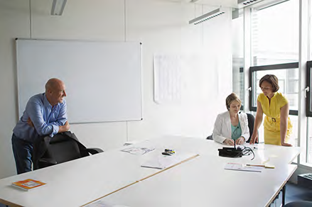
Quality Drivers
Improved Quality drives customer experience that results in increased revenue/profit.
Companies with a strong culture of quality differentiate themselves through high performance leading to fewer mistakes, an enhanced customer experience, and higher customer loyalty.
Companies with a high culture of quality have employees who make * 46% fewer errors, 75% fewer “significant” errors, and 75% fewer customer-facing product errors, compared with companies with a low culture of quality
* Source - ASQ - Establish an Environment Where Employees “Live” Quality – 2014

Slide 7
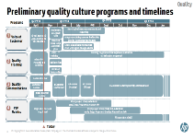
Quality Culture Initiative summary
    Accelerate product quality and customer experience improvement by cultivating quality-driving behaviors and metrics to address cultural barriers
Purpose
Interviews & Analysis
Cultural Quality Barriers
Quality Behaviors
1
2
3
Quality
Copyright 2018 Hewlett Packard Enterprise Development LP
Prioritization
Solution design
Implementation
4
5
6
Project Charters
Owner | HR regional manager |  | Mechanism Prioritization
Parties involved | Sales events agenda owners | Managers
Implementation details | CMs to share inspiring examples of How thoughtful risk taking paid off during sales events and team meetings How they created attack plans in their countries during sales events and regional meetings Real-life, detailed direct involvement in large deals at certain events (e.g., Peter Ryan in Frankfurt) Successful CMs to share best practices (e.g., how they manage their day: 20% business management, 30% admin roles and people management, 50% customer facing)
Sustainability | Leadership to ensure storytelling is part of sales events Leadership to volunteer CMs to share experience per event
Prerequisites | Storytelling opportunities in meeting / event agenda
Measurement | Number of storytelling opportunities
Next steps | Core team to identify upcoming CM sales events in Americas Core team to coordinate with agenda owners of sales events to identify storytelling opportunities and potential candidates for public speaking based on manager input HR regional manager to engage with managers to communicate additional responsibilities to CMs

Slide 8
1
Pride building enlists the best front line motivators
Pride builders are highly respected individuals who excel at helping colleagues feel good about their work – in turn, delivering great results
Where They Are
What They Do
    Create emotional commitment to achieving high performance in their daily tasks
    Provide focus and accountability to high standards
    Get to know the “whole person” including personal goals and motivations
    Foster a culture of continuous improvement
    Show how work connects to the “bigger picture”
    Encourage frontline innovations and help spread them across the enterprise
Where Pride builders reside
BU & Functional
Leadership
Front line Management

Slide 9
Quality Culture Programs
Four programs tailored to drive cultural change
Objectives
Increase value and usage of VoC data
Improve processes and decision making with actionable customer data
Objectives
Raise frequency, and consistency of communications about quality issues (e.g. culture, customer insights)
Deepen understanding of quality tools available
Voice Of
Customer
Quality
Communication
Visibility &
Adherence
Quality
Culture
Objectives
Increase visibility into the Design process and provide early warning on quality issues
Increase cross functional collaboration
Objectives
Educate staff on how they can contribute to quality culture and tools they can use
Engage staff to commit to the Quality Imperatives and new behaviors
Quality
Metrics
Quality
Training

Slide 10
Quality Employee Development

Slide 11
TCE Ecosystem
Recognise and accommodate business needs by means of an integrated approach to continuous improvement
Exploit already existing employee skills such as Internal Assessors, Greenbelts, Blackbelts and Master Blackbelts
Continually develop our competencies by means of a tailored focused improvement curriculum
Business needs
Employee skills
Improvement curriculum

Slide 12
Address business needs
EFQM/Baldridge, Benchmarking
Strategic Plan
Define core processes
Monitor core processes
Identify opportunities for improvement
Improve Customer loyalty
Business improvement model
Improve Share of Wallet
Improve customer impacting processes
Increase revenue
Deliver sustainable competitive advantage
Promote best practice externally
Top Spender Loyalty Initiative
Customer experience design
Quality Management System
Business Improvement
Operating Model
Execute internal and external assessments, measure process maturity, operational results (BSC)
Customer insight
Gap analysis, Hoshin Planning
12
Lean Sigma

Slide 13
Quality Core Curriculum
Qbasics
MSc Quality Management
MBB coaching
Blackbelt Training
Project Management Training
Greenbelt Training
Internal Assessor Training
Automated Toolkit
Skills hierarchy and distribution

Slide 14
Linking HP’s BB’s to MSc
12 – 15 months
Leading to the Award of an Portsmouth MSc in Strategic Quality Management
MSc Curriculum
Green Belt
HP Black Belt Content
Portsmouth University Content
Research/Thesis

Slide 15
MSc SQM

Slide 16
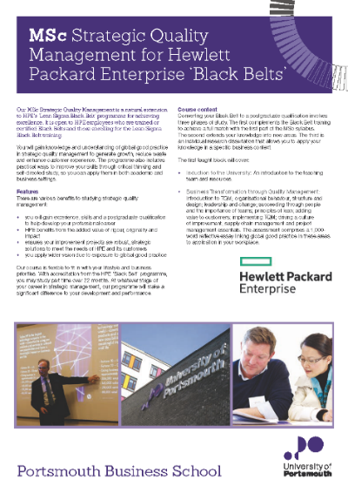
Objectives of the Programme
To extend the depth of knowledge and skills provided by HPE in-house Lean Sigma Black Belt training
To provide experience, skills and a postgraduate qualification that develops Black Belts to the next level
To deliver to HPE the added value of rigor, originality and impact
To develop future Quality Leaders who understand Strategic Quality Management and benefits derived from having an excellent Culture of Quality

Slide 17
Course Curriculum
Business Transformation through Quality Management:
Introduction
Organizational behavior, structure and design
Leadership and change
Succeeding through people and the importance of teams
Principles of lean
Adding value to customers
Implementing TQM
Driving a culture of improvement
Supply chain management and project management essentials
Business Systems: Concepts, Management and Evaluation:
Maintaining excellence through business process standards for quality
Environmental impact, health and safety
Balancing control requirements with the need for innovation, design and change
Business information for quality improvement
Performance measurement and management, including ServQual, QFD and benchmarking
Quantitative and Research Methods:
Using online library facilities
Research methods for professional investigations
Quantitative methods and data gathering techniques for problem solving
Applying SPC appropriately including hypothesis testing and confidence intervals, analysis of failure data and design of experiments.
Effective Strategic Quality Management:
Aligning quality improvement with competitive advantage
Strategic goals of the organization;
Variations in culture and relationships with stakeholders
Leadership and realizing the quality vision, learning organization and coaching
Corporate social responsibility and risk
Supply chain management approaches
Advanced research methods and techniques

Slide 18
Student Feedback 1/2
Some examples from recent graduates
“I’ve found the course to be
very interesting and relevant to my role in HP. It has been enjoyable to step back from the day-to-day work and look at higher level questions of how and why”
“SQM has given me whole new perspectives, has equipped me with new methods and connected me with some extraordinary colleagues, and step by step we’re leaving our prints in the work we perform”
“The effect of taking the course had been
better than a pay rise!”
  “Proven process maturity assessment approach, strengthening my BPM skills and enhancing my knowledge on new methods, which are now being used in my daily work”
“In one of our other teams I drove people to look beyond the HP-world that they probably
know too well by now, and they explored, not necessarily academic, but nonetheless, valuable market and area-development information, leading them to identify some innovative and game-changing ideas to pursue”
  “It helped me focus in a way I had not seen before. I found I was able to review my work in a more critical way allowing me to separate the important items from the rest”
  “Significantly contributed to my knowledge needed to do better job as a Customer Experience and Quality Lead”
Source : University of Portsmouth
Used with permission of respondents

Slide 19
Student Feedback 2/2
Some examples from recent graduates
“The Strategic Quality Management programme was an exciting journey, a logical extension of my professional development following the LSS curriculum path, which built on my Black Belt knowledge, and practical experience. It provided the seminal theoretical background and expand my strategic view as quality professional by changing my mind-set from what Pedler (2011, p. 135) calls from a domestic to a global mind-set.”
“My self-confidence, professionalism, passion for Quality -and even for life- are greater than never before. I felt injected with wisdom, method, humanity, speed, complexity solving, pragmatism, solidarity, solemnity, sense of accomplishment, worth of effort , value of diversity, genuine respect and continuous learning desire. So now, I feel better in the broadest sense of the term, as a quality professional and as human being- I should admit I even feel younger !!!”
“The constant Critical Thinking attitude, the Literature review approach to learn and the structure method to build meaningful conclusions and recommendations in every scope of life ( professional and personal ) have reported significant benefits, often hard to measure from a quantitative perspective but very solid from a qualitative one.”
“My role has clearly shifted from a tactical to a strategic one, my interlocution level has significantly raised and my influencing skills have drastically improved.”
“I have developed a more effective way of thinking and narrow it down to the points that matter going through the “So What” iterative process. I also gain confidence to share and communicate my ideas and knowledge with the senior management team. I was using what I learned during my education to help and transform my old team and I will continue to use it in my new position as the existing strategy and KPIs need to be review and updated.”
Source : University of Portsmouth
Used with permission of respondents

Slide 20
Intangible Benefits
The organisation is giving back something in return
Feeling recognised by the organisation
Becoming more strategic in the approach
Change in thought process to accept others ideas and learning from the external work
Moving from internal to external focus
Reflection of the organisation’s core systems, processes and performance
Building confidence to do continuously learn and incorporate research into practical work
Keep the thought process engaged in innovation
Working and Learning about other Cultures
Finally increased Employee Engagement
  – increased contribution to organisations goals and increased commitment contributing to Tangible ROI (increased efficiency, improved and efficient processes, growth etc)

Slide 21
Thank you

