Slide 1
Global Research Project: 21st Century Top Management Challenges in Quality, Procurement and Supply Chains
CQI Corporate Partners Workshop: 5th March 2019
John Oakland; Professor Emeritus at Leeds University Business School; Founder & Director of Oakland Institute for Business Research and Education
Dr Katey Twyford; Research Associate, Oakland Institute for Business Research and Education
Mike Turner; Partner, The Oakland Group; CQI Board Member & author of QP e-booklets
(Professor Chee Wong, Director of the Centre for Operations and Supply Chain Research, LUBS
Dr Thorsten Makowski, CEO Valueneer GMBH; Faculty member European business schools)

Slide 2
21st Century Top Management Challenges in
Quality, Procurement and Supply Chain Management
The research team postulated that top managers in many companies have lost sight of quality, reliability, supply chain and procurement issues, based on the examples of high profile horror stories that appear in the global press nearly every week.
However, we believe there are exemplar companies out there which know how to create the right cultures and management capabilities to run businesses well. We hope that a study of a sample of exemplar companies will allow us to develop existing and new frameworks that will address the whole set of requirements to assist top management regarding quality and supply chains.
The research team have carried out much prior empirical work on quality, procurement and supply chain issues to establish the elements of suitable approaches. The aim of this research is to put flesh on those frameworks and to identify good practice and ‘route maps’ for top management guidance. The aim will be to publish the findings in high profile journals and business magazines.
We have carried out a global on-line survey, and we are now interviewing CEOs, CQOs & CPOs from selected top performing companies. This will allow us to determine the main features of successful approaches, and how top managers from other companies can learn from the best.
Hence, these initial results from the on-line survey part of the work aim to:
a) estimate how well Top Management are seen to be performing regarding Quality, Procurement & SCM;
b) identify possible good practice companies for the interviews/further/case study part of the research.

Slide 3
CQI Corporate Partners’ Workshop 5th March 2019
This workshop will be a mix of a presentation of the initial findings of the on-line survey results, followed by facilitated working sessions to explore some key questions that the team is currently investigating.
Delegates should benefit in the following ways:
They will gain a deeper understanding of the good and not so good practices of companies in the research sample, with the opportunity to ask questions;
They will have the opportunity to share experiences and wisdom with fellow Corporate Partner delegates and learn from these exchanges;
The results of these workshops will be integrated with the results of the interviews and the delegates will receive a complimentary advanced copy of the completed research.
We will also collect their particular issues regarding culture and be ready to run a very tailored and focused CQI session on this subject later in the year.

Slide 4
1. Key Findings – walk it like you talk it!
CEOs and executive teams are better at demonstrating leadership, commitment and setting strategy than ensuring implementation of quality management
Most CEOs were reported to demonstrate a clear leadership and commitment to quality, AND set a clear vision and strategy which includes quality
However, the surveyed companies are overall poorer at:
  CEOs ensuring that quality policies are aligned with the company strategy
  Executive teams promoting and supporting continuous improvement throughout the company and supply chain
  Executive teams ensuring there is a well developed knowledge of quality tools and techniques throughout
  the company
2. To reduce failures and recalls of products CEOs and executive teams need to demonstrate leadership,
commitment and set strategy AND be good at implementing quality management
The CEO and executive team appear to contribute to lowering the rate of major failures or recalls; there was correlation
between companies with zero or less than three high profile quality failures AND:
  CEOs demonstrating clear leadership and commitment to quality
  CEOs setting a clear vision and strategy which includes quality
  CEOs ensuring that quality policies are aligned with the company strategy
  Executive teams promoting and supporting continuous improvement throughout the company and supply chain
  Executive teams ensuring there is a well developed knowledge of quality tools and techniques throughout
  Hence; leadership, commitment, clear quality vision, quality aligned in strategy and continuous improvement are shown, statistically significantly, to help reduce the number of major failures or recalls

Slide 5
Key Findings – areas for improvement
3. Vigilance in promoting risk-based approaches is not enough without effective quality planning and a
culture of fact-based decision-making
Two thirds of companies said their executive team was vigilant in promoting risk based approaches but:
  A fifth of respondents report quality related costs at 2 - 5% of revenue, with nearly 30% reporting it higher
  The average company has had two or three high profile quality failures in the last three years
  Nearly a third of companies did not say that their executive team requires the root
  causes of failures to be identified
  30% of companies said (or were unsure) that they do not have effective quality planning to prevent problems

Slide 6
Key Findings – opportunities
4. Prioritise improvement on standardisation of quality/risk management processes and interfaces with
supply chains and procurement
  A majority of companies said their executive team understands the importance of supply chain quality assurance BUT nearly a third of companies did not report having effective governance in place to eliminate supply chain risks
  Quality and supply chain performance is enhanced when executives promote and support continuous improvement throughout the company and supply chain
The most commonly cited areas for potential improvement in quality of supplies was through:
  better and faster interfaces within the company and with suppliers, and
  having standardized processes.

Slide 7
Key Findings – interfaces matter
There is better governance of supply chain risk and higher standing of quality, procurement and supply
chain management in companies that have quality and supply chain management functions represented in the Boardroom
  Three quarters of companies said the interface between procurement / supply chain management functions and the executive team of their company was good or very good but less than 50% of companies had both supply chain and quality functions represented on their Board or C-level executive team
Interfaces are crucial for maintaining quality and reducing supply chain risks
The interface between the CEO, Supply Chain Management and Quality Management at board level is
being explored further in the next stage of the research

Slide 8
2. About the sample population
This report draws on responses from 140 organisations from across the world.
16 major industry sectors are represented in the responses, together with a number of small or unspecified sectors.
The top sectors responding included engineering & manufacturing, food and beverages, fast moving consumer goods, telecommunications, computer and information services, automotive, and electrical and electronic.
One third of the respondents were CEO’s, senior executives or directors.
43% of respondents represented the procurement function, 14% the supply chain management function, and 11% the quality function.

Slide 9
The study was truly global
Companies from 39 different countries across 5 continents participated
4 countries
19 countries
11 countries
Europe
North-, Central-
and South America
Austria, Croatia, Czech republic, Denmark, Finland, France, Germany, Greece, Hungary, Ireland, Italy, Kosovo, Netherlands, Slovenia, Spain, Sweden, Switzerland, Turkey, United Kingdom
Asia
Azerbaijan, Bangladesh, India, Indonesia, Lebanon, Pakistan, Singapore, South Korea, Taiwan, Thailand, United Arab Emirates
Brazil, Canada, Colombia, United States
3 countries
2 countries
Africa
Egypt, Kenya, Swaziland
Australia and Oceania
Australia, New Zealand

Slide 10
A third of the participating companies had a revenue of over €1 billion per annum
Annual turnover of participants 2016 in EUR million
12%

Slide 11
The survey has a good representation across industry sectors

Slide 12
3. Leadership and commitment to quality
The CEOs of most companies were reported both to demonstrate clear leadership and commitment to quality AND to have a clear vision and strategy which includes quality (no significant difference between the two).
However, respondents reported that CEOs were overall poorer in ensuring that quality policies are aligned with the company strategy (significant difference).
Although the executive teams support continuous improvement throughout the company and supply chain in nearly 80% of companies, only two thirds of executive teams ensure that there is a well developed knowledge of quality tools throughout the company (significant difference).
Nearly a quarter of responding companies report quality related costs at between 2 - 5% of revenue, with some poorer performers reporting quality related costs as higher than 5%.

Slide 13
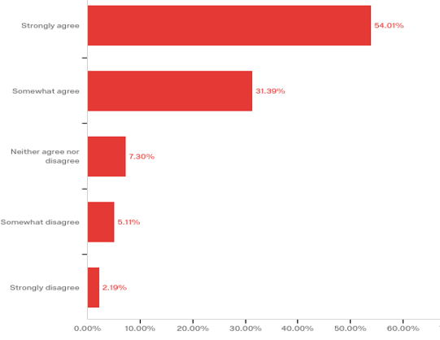
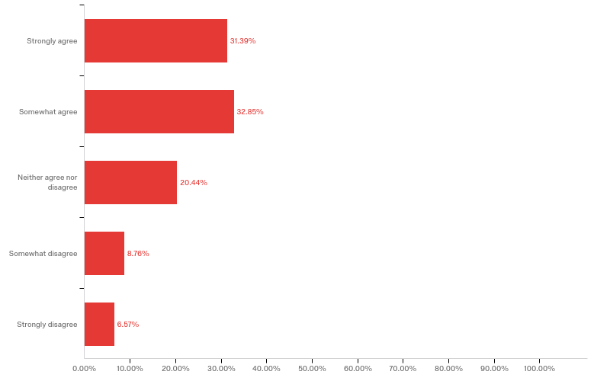
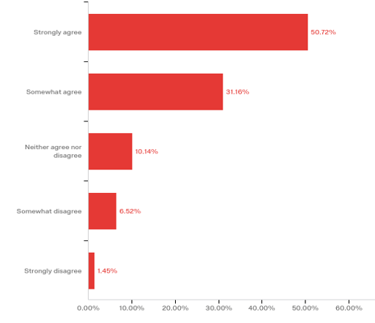
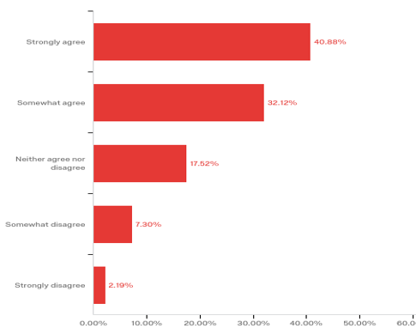
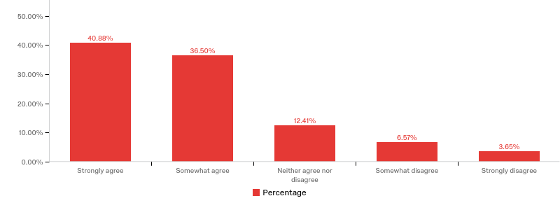
Leadership and Quality: The Responses
Strongly agree
Strongly disagree

Slide 14
Most companies use multiple KPIs to measure and evaluate the cost of quality

Slide 15
A fifth of respondents report quality related costs at 2 - 5% of revenue, but nearly 30% reported it higher

Slide 16
4. Strategic Priority of Quality within the Company
Two thirds of respondents said their CEO communicates
the importance of conforming to quality management systems throughout
the company and its supply chain.
But 12% of respondents considered the reputation of quality management in
their company to be low or very low and one in ten companies said that
quality was of low importance in the strategy and positioning of the company.
More than one in four companies has no board or C-level executive responsible
for either SCM or quality.

Slide 17
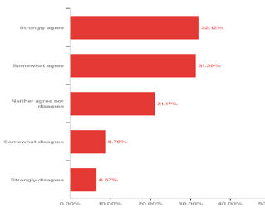
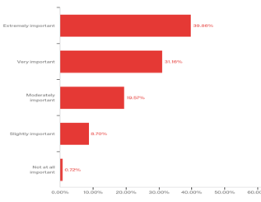
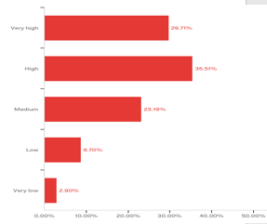
Strategic Priority of Quality within the Company: The Responses
Strongly disagree
Strongly agree

Slide 18
Are there board/c-level executives responsible for supply chain management and/or quality in your company?
Quality
Yes
No
Yes
49%
17%
Supply
Chain
Management
No
7%
27%

Slide 19
5. Managing Quality Risks
The average company has had two or three high profile quality failures in the last three years.
Poorer performers are significantly worse (nearly a fifth with three or more high quality failures).
Two thirds of companies said their executive team was vigilant in
promoting risk based approaches BUT one in four companies did not say
that their executive team promotes a culture of decision making based
on factual evidence.
Nearly 30% of companies said their executive team does not require the root
causes of failures to be identified or were not sure.
80% of companies said the executive team understands the importance
of supply chain quality assurance BUT nearly a third of companies did not report having effective governance in place to eliminate supply chain risks.
30% of companies said they do not have effective quality planning to
prevent problems or were unsure.

Slide 20
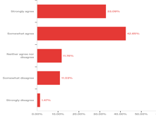
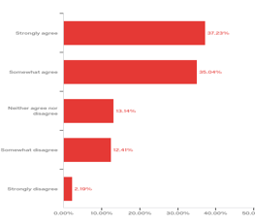
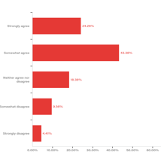
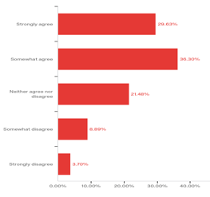
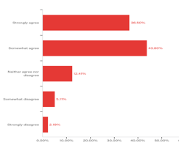
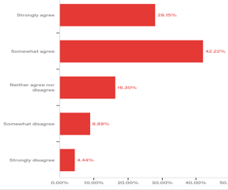
Managing Quality Risks: The Responses

Slide 21
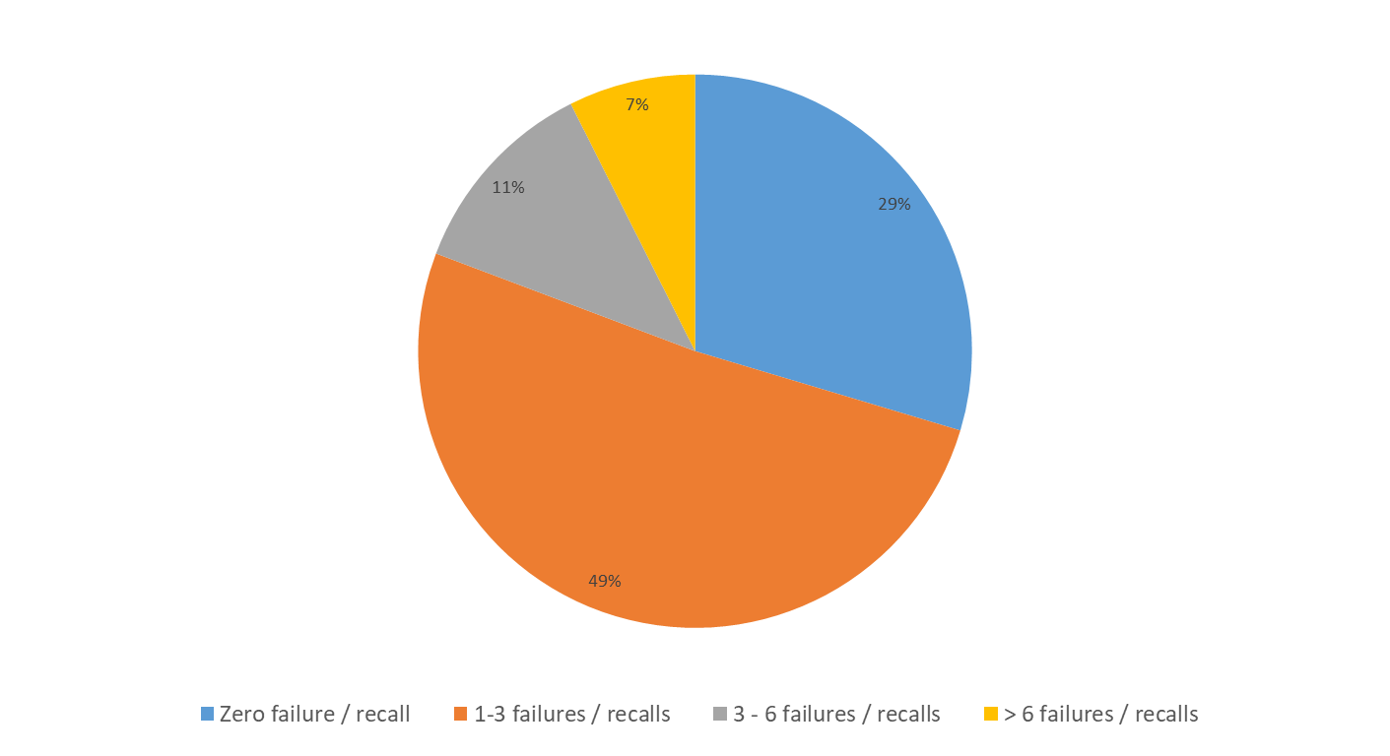
Half the respondents have had between one and three high profile quality failures in the last three years, with poorer performers having significantly more
Percentage respondents with high-profile quality failures or product recalls during the last 3 years

Slide 22
Does the CEO and executive team contribute to lowering major failures or recalls?
YES – companies had fewer (less than three) quality failures/recalls when:
CEOs demonstrated leadership and commitment to quality;
CEOs had a clear vision and strategy which includes quality;
CEOs ensured that quality policies are aligned with the company strategy;
Executive teams promoted and supported continuous improvement throughout the company and supply chain;
Executive teams ensure there is a well developed knowledge of quality tools and techniques throughout the company.
The above factors were statistically significant in affecting the number of major quality failures/recalls.

Slide 23
Reducing major failures by fact-based decision making, quality and risk governance and risk prevention
Other factors that significantly affect the number of major failure/recalls include:
Executives promote a culture of decision-making based on factual evidence;
There is an effective governance policy and process to eliminate quality and supply chain risk;
Potential problems are prevented through effective quality planning in the company and the supply chain.
Factors that did not appear on their own to significantly affect the number of major failure/recalls include:
Requiring the true root causes of risks and failures to be clearly identified;
Executive understanding the importance of supply chain quality assurance;
Executive vigilant in promoting risk based approaches to the supply chain;
Company good at quality/supply chain performance compared to competitors.
These areas will be explored further in stage 2 of the research.

Slide 24
Does CEO and Board level representation of quality and supply chain function impact on the number of product failures or recalls?
YES – there were less failures or a higher chance of zero failure when:
  CEOs communicated throughout the company and its supply chain the importance of conforming to quality management systems
  There are board-level supply chain management and/or quality management representatives
The interface between the CEO, Supply Chain Management and Quality Management at board level is being explored further in stage 2 of the research

Slide 25
6. Supply chain management and procurement
Factors that significantly affected quality / SCM performance are:
  Executives promote and support continuous improvement throughout the company and supply chain;
  The standing of procurement / supply chain management in the company.
The most commonly cited potentials to improve material quality supplies are:
  Having better and faster interfaces between internal functions within the company and with external suppliers, and
  Having standardized processes.
One in ten companies have acquired suppliers many times to improve quality.
There appears to be a significant commitment to local procurement with one in four companies sourcing over half of its supplies locally.
When comparing quality problems caused through the manufacturing and transportation processes a quarter of companies reported no quality problems caused by transport; a further 60% of companies said less than 10% of their problems were caused by transportation.

Slide 26
7: Procurement and supply chain’s roles in quality management
Three quarters of companies said the interface between procurement / supply chain management functions and the executive team of their company was good or very good:
At three out of four companies the directors and managers are said to communicate quality issues effectively with the CEO;
80% of companies described the interface between the quality function and the CEO of the company as good or very good;
Three out of four Chief Procurement Officers are described as far sighted and visionary, and the majority (84%) of companies said they had specific controlling of procurement and supply chain activities.
BUT
Only one in eight companies say the standing of procurement and supply chain management in their company is very high, with most rating it as high or medium;
One in five companies said that a procurement and supply chain management strategy had not been communicated within their company or they were not sure;
One in eight companies say they do not have fully standardised and documented procurement and
supply chain management activities.

Slide 27
Summary of Key Findings & Implications
Drawing on a sample population of 140 companies from across the world representing 16 major industry sectors, the survey produced statistically significant result which show that:
CEOs and executive teams are better at demonstrating leadership, commitment and setting strategy than ensuring implementation of quality management
To reduce failures and recalls of products CEOs and executive teams need to demonstrate leadership,
commitment and set strategy AND be good at implementing quality management
Leadership, commitment, clear quality vision, quality aligned in strategy and continuous improvement are shown, statistically significantly, to help reduce the number of major failures or recalls
Vigilance in promoting risk-based approaches is not enough without effective quality planning and a culture of fact-based decision-making
There is a need to prioritise improvement on standardisation of quality/risk management processes and interfaces with supply chains and procurement
There is better governance of supply chain risk and higher standing of quality, procurement and supply chain management in companies that have quality and supply chain management functions represented in the Boardroom
Interfaces are crucial for maintaining quality and reducing supply chain risks and the interface between the CEO, Supply Chain Management and Quality Management at board level is being explored further in next stage of research

Slide 28
Workshop session questions
1. How do you identify and eliminate risks in the operations and supply chains?
What major risks or failures have you encountered recently?
2. How do you balance/prioritise critical product quality and supply chain risks against shareholder pressure for profit?
3. How does your organisation keep up with the pace of innovation while reducing quality and supply chain risks?
4. Is quality and supply chain/procurement represented on the Executive Board?
If not, why not?
How do you ensure interfaces and communication between executives and operations work?
5. How do you ensure the implementation of the quality and supply chain strategies to reduce costs and high-profile failures?
How does the CEO and Executive Board work with operations to achieve this?
6. How would you describe the culture in your organisation right now?
What role does quality planning in the supply chain play?
What role does decision making based on factual evidence play?

